Slide 1
EASWARI ENGINEERING COLLEGE
Department of Information Technology
IOT BASED ACCIDENT DETECTION AND PREVENTION REPORTING SYSTEM
Supervisor
Dr. M. Mohana
Associate Professor
Department of Information Technology
Project by,
Akshay Ram R - 19205007
Arul Rajan K - 19205012
Arunkumar R - 19205013
Date: 19/ 04/ 2023

Slide 2
OUTLINE
Objective
Abstract
Existing system/Literature Survey
Limitations in Existing System
Proposed system
System Design
Flow Chart
Implementation
Performance Analysis
Output
References

Slide 3
OBJECTIVE
The main objective of this project is to improve road safety by detecting potential accidents and warning drivers.
The system integrates various sensors and technologies to collect and analyse data and uses this information to identify potential risks and provide timely alerts.
Detecting and preventing accidents caused by alcohol-impaired driving.
Identifying potential accidents caused by driver fatigue or distraction by integrating temperature sensors.
The eye blink sensor monitor the driver's physical and mental state, and providing alerts or interventions if the driver is at risk of falling asleep or losing focus

Slide 4
ABSTRACT
The primary goal of this research is to prevent collisions brought on by intoxicated driving, unanticipated drowsiness, and engine overheating. If more variables lead to the crisis, the used embedded systems will surely be able to convey a fast communication and accurate location to the emergency services the need to gather the necessary the victims. When a crash occurs the sensor promptly sent a message with all the necessary information to the emergency number. This system ensured that the accident victim gets assistance swiftly. The findings provide the precise location of the occurrence.

Slide 5
LITERATURE SURVEY 1
[1] Title: Intelligent Accident Detection and Ambulance Rescue System Using GPS and GSM Modems
Author: D. Sai Prasad, R. Usha Rani, and S. Aneesh Kumar.
Year: 2019
This paper proposes an accident detection system that uses GPS and GSM modems to send an SMS to emergency services and the victim's family. The system also includes an alcohol detection unit and a heart rate sensor to detect the driver's physical condition.

Slide 6
LITERATURE SURVEY 2
[2] Title: A Machine Learning-Based Vehicle Accident Detection System Using Sensors and GPS
Author: R. C. Roy and S. Das
Year: 2020
The paper presents a machine learning-based system that detects vehicle accidents using data from sensors and GPS. The system is designed to automatically detect accidents in real-time, which can help emergency services respond quickly and efficiently. The authors then use machine learning algorithms to analyze the sensor and GPS data and detect whether an accident has occurred.

Slide 7
LITERATURE SURVEY 3
[3] Title: Smart Accident Detection and Monitoring System for Road Safety
Author: V. Jeyanthi and K. Govindarajan
Year: 2021
The paper proposes a smart accident detection and monitoring system for road safety. The system is designed to detect accidents in real-time and notify emergency services automatically. The system utilizes GPS and GSM technology to detect accidents and send alerts to emergency services.

Slide 8
LIMITATIONS IN EXISTING SYSTEM
Possibility of false reporting about the accident.
No alcohol sensing device.
Temperature sensor is not used.
Damage to the sensor cannot be detected.

Slide 9
PROPOSED SYSTEM
The proposed system helps with taking precautionary measures to prevent accidents from happening, with the use of various sensors.
Sensors used for the operation are Eye-blink sensor, Alcohol sensor, LM 35 sensor and Crash Collision Sensor.
This work introduces an integrated accident detection and reporting system (ADRS) to overcome existing shortcomings in the ADRS, To achieve higher accuracy, we use a combination of IoT and Decision Tree.

Slide 10
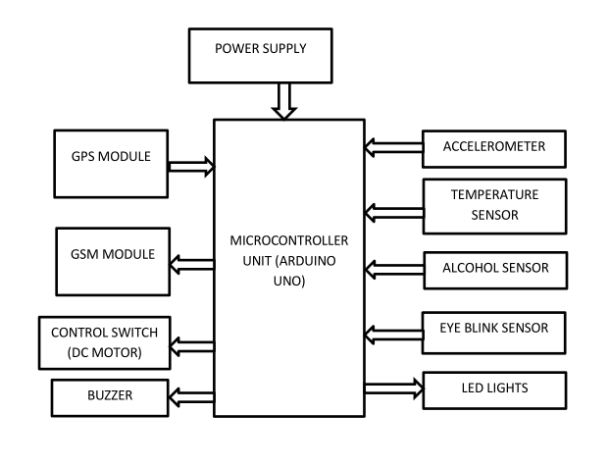
SYSTEM DESIGN

Slide 11
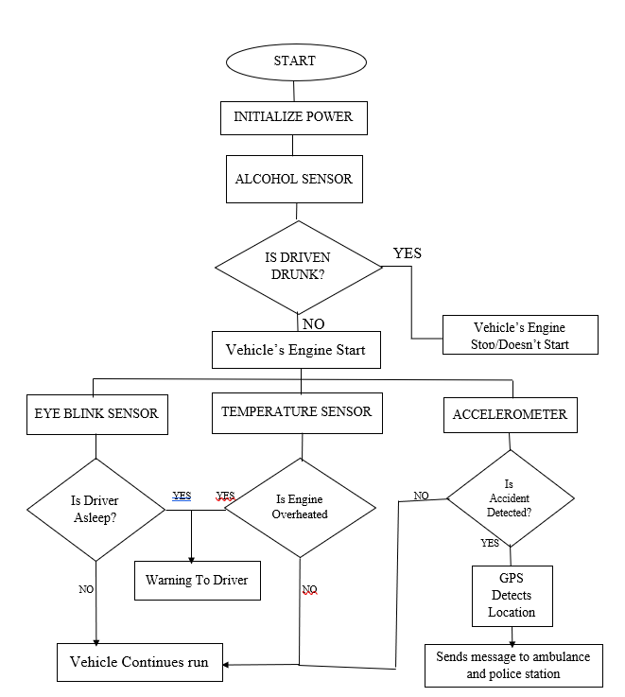
FLOW CHART

Slide 12

IMPLEMENTATION

Slide 13
Performance Analysis

Slide 14
Performance Analysis
Electrooculography (EOG) Technique

Slide 15
Output
Crash Detector

Slide 16
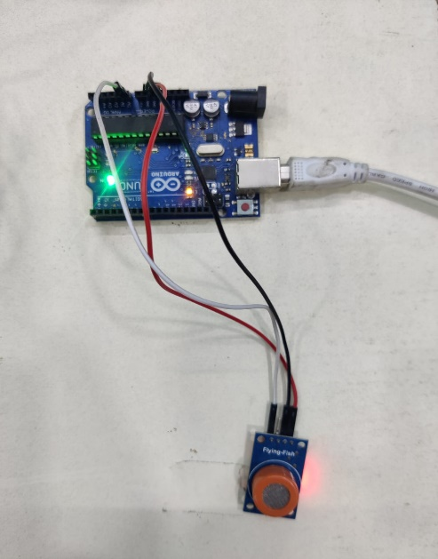
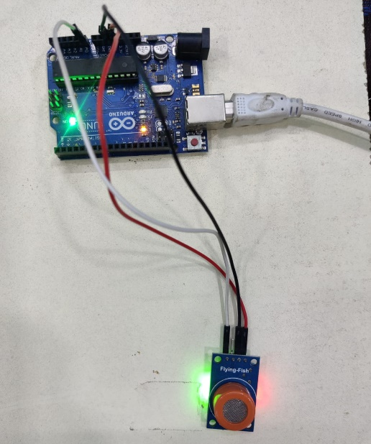
Output
After Detection
Before Detection

Slide 17
REFERENCES
"A Comprehensive Review on Vehicle Accident Detection and Notification System" by R. Vijayakumar and D. Kavitha, International Journal of Scientific Research in Computer Science, Engineering and Information Technology, vol. 5, no. 1, pp. 366-371, 2020.
“A Machine Learning-Based Vehicle Accident Detection System Using Sensors and GPS" by R. C. Roy and S. Das, IEEE Sensors Journal, vol. 20, no. 17, pp. 10182-10193, 2020.
“Smart Accident Detection and Monitoring System for Road Safety “byV. Jeyanthi and K. Govindarajan 2021

Slide 18
THANK YOU

